Slide 1

Sleep Stage Detection Using Machine Learning Algorithm

Slide 2
Project Overview
The project is related to automatically classifying the different stages of sleep based on recorded physiological signals.
Wakefulness, REM, and NREM sleep phases occur throughout sleep.
Experts manually score polysomnography (PSG) recordings of EEG, EOG, and EMG data to distinguish sleep stages.

Slide 3
Objectives
Automation
Efficiency
Consistency
Accuracy
Reliability

Slide 4
Dataset
The dataset is obtained from Haaglanden Medisch Centrum (HMC) in The Hague, The Netherlands.
Publicly available on PhysioNet and was collected in 2018 but published recently on July 1, 2021.
The dataset consists of whole-night PSG sleep recordings from 154 individuals(88:66), with an age range of 38 to 70 years.
Three EEG channels, namely F4, C4, and O2.
Five EEG waves, namely δ,θ,𝛼,β and 𝛾.

Slide 5
Preprocessing
Missing Value Finding.
Label Encoding.
Train Test Split.
Imbalance Dataset(Oversampling).

Slide 6
Model Selection
Random Forest Classification
Scalability to huge datasets,
Superior performance in terms of criteria like accuracy, precision, recall, and F1-score

Slide 7
Model Training
Trained the model to get predicted value.
(n_estimator) and (max_depth) parameters are tuned to get max accuracy.
Get less accuracy with default parameters.

Slide 8
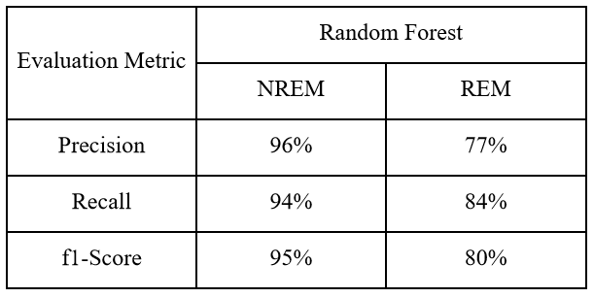
Model Evaluation

Slide 9
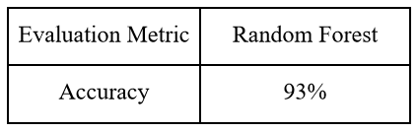
Result
Final Performance Metric Results For Models

Slide 10
Conclusion
This machine learning model for identifying sleep stages from EEG data has been built and validated.
Used a number of criteria to assess the model's efficacy; test results showed good accuracy and an F1 score.
Several potential real-world applications of the model were identified and discussed. These included the diagnosis of sleep disorders, monitoring of sleep quality, improvement of performance, and enhanced athletic ability

Slide 11
Future Work
Gathering additional data from a wider range of people.
To enhance the model's precision and performance, we will investigate alternative feature extraction methods and machine learning algorithms.
Creating a tool that can be used by both medical professionals and patients to monitor and analyze sleep patterns in real time.

Slide 12
References
Madsen PL, Schmidt JF, Wildschiodtz G, Friberg L, Holm S, Vorstrup S, Lassen NA. Cerebral O2 metabolism and cerebral blood flow in humans during deep and rapid-eye-movement sleep. Journal of Applied Physiology. 1991b;70(6):2597–2601.
Ellis CA, Zhang R, Carbajal DA, Miller RL, Calhoun VD, Wang MD. Explainable Sleep Stage Classification with Multimodal Electrophysiology Time-series. Annu Int Conf IEEE Eng Med Biol Soc. 2021 Nov;2021:2363-2366. doi: 10.1109/EMBC46164.2021.9630506. PMID: 34891757.
Santaji, S., Santaji, S., Desai, V. Automatic sleep stage classification with reduced epoch of EEG. Evol. Intel. 15, 2239–2246 (2022)

Slide 13
Question & Answer

Slide 14
Presenter’s Name
Md. Rakibul Islam Nahid
ID: 2537 || Reg: 1797
Rifa Tamanna Mitu
ID: 2525 || Reg: 1780
Rifat Ara Nur Rekha
ID: 2534 || Reg: 1793
18th May, 2023
Thank You

